Slide 1

MKT 465
Marketing Analytics Project
Discrete Choice Models
Logit and Probit

Slide 2

Continuous Y Variable Regression
Demand Estimation (Market Mix Models)
Aggregate data (store, chain, area, outlet type, national)
Aggregate data example
  155 weeks at 1 store
  Hunts Ketchup
    Sales (oz.)
    Regular price ¢/per oz.
    Percent Discount [(reg. P − deal P)/reg. P]
    Advertising 0/1
    Display 0/1

Slide 3
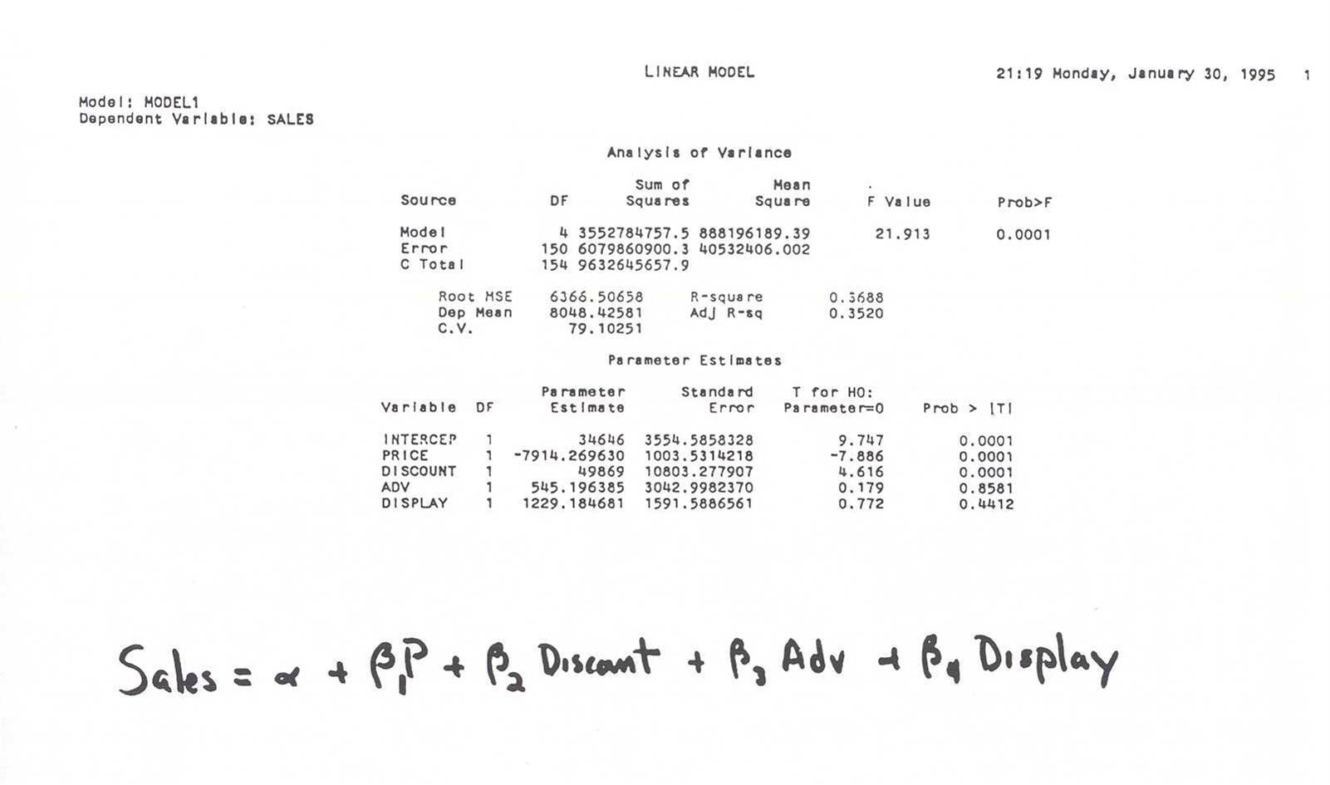
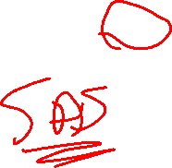

Slide 4
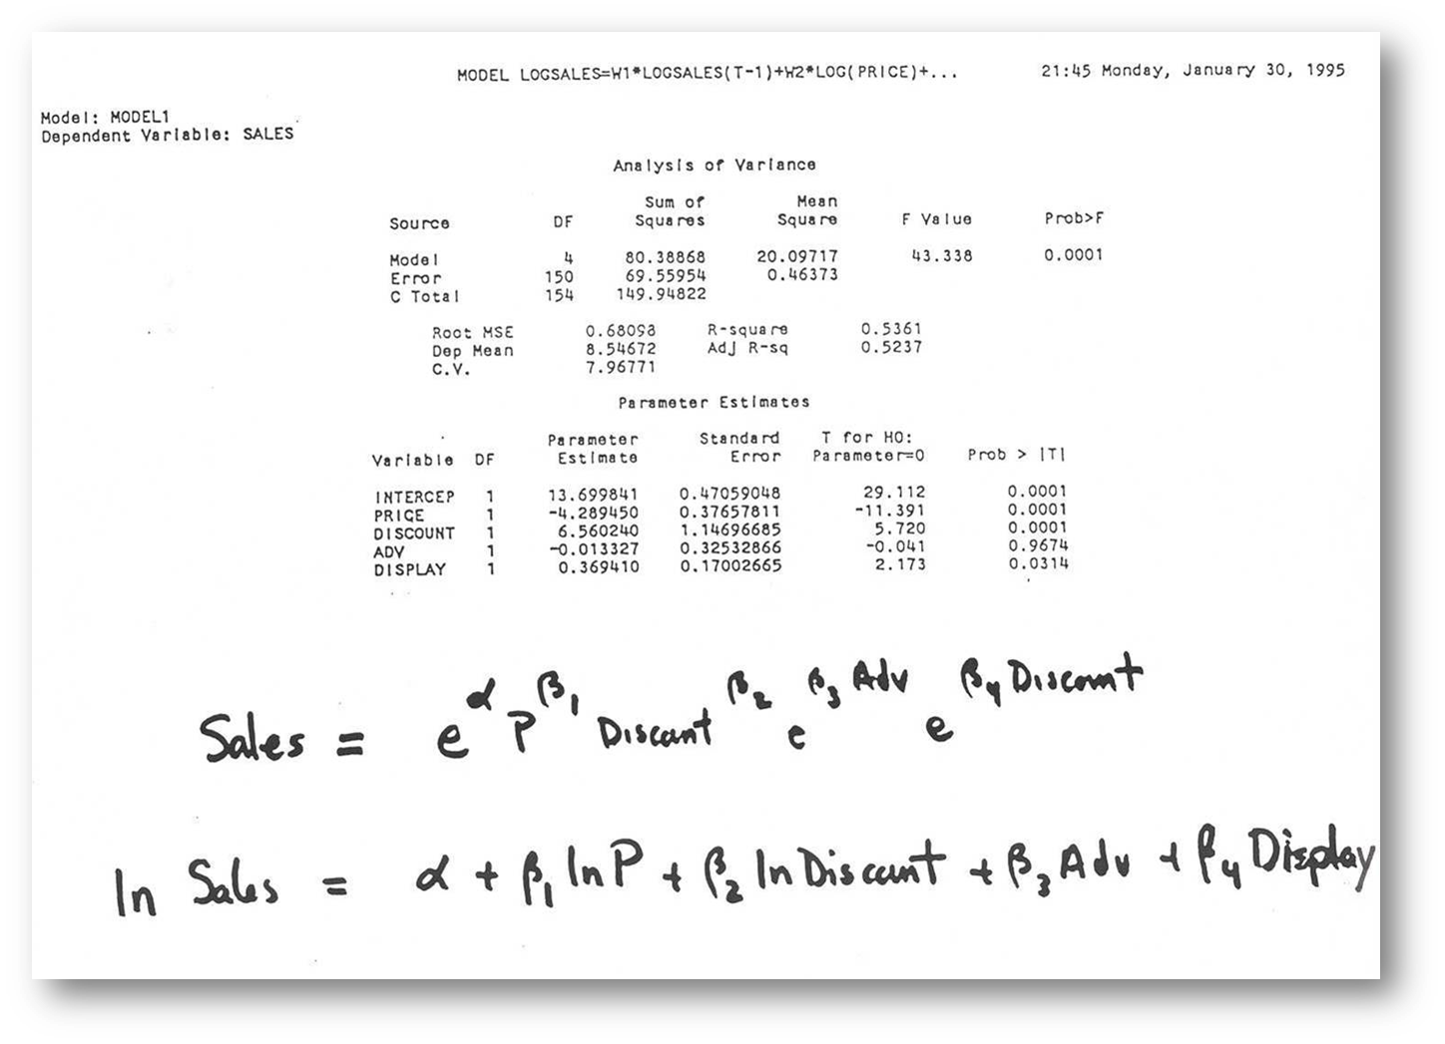

Slide 5
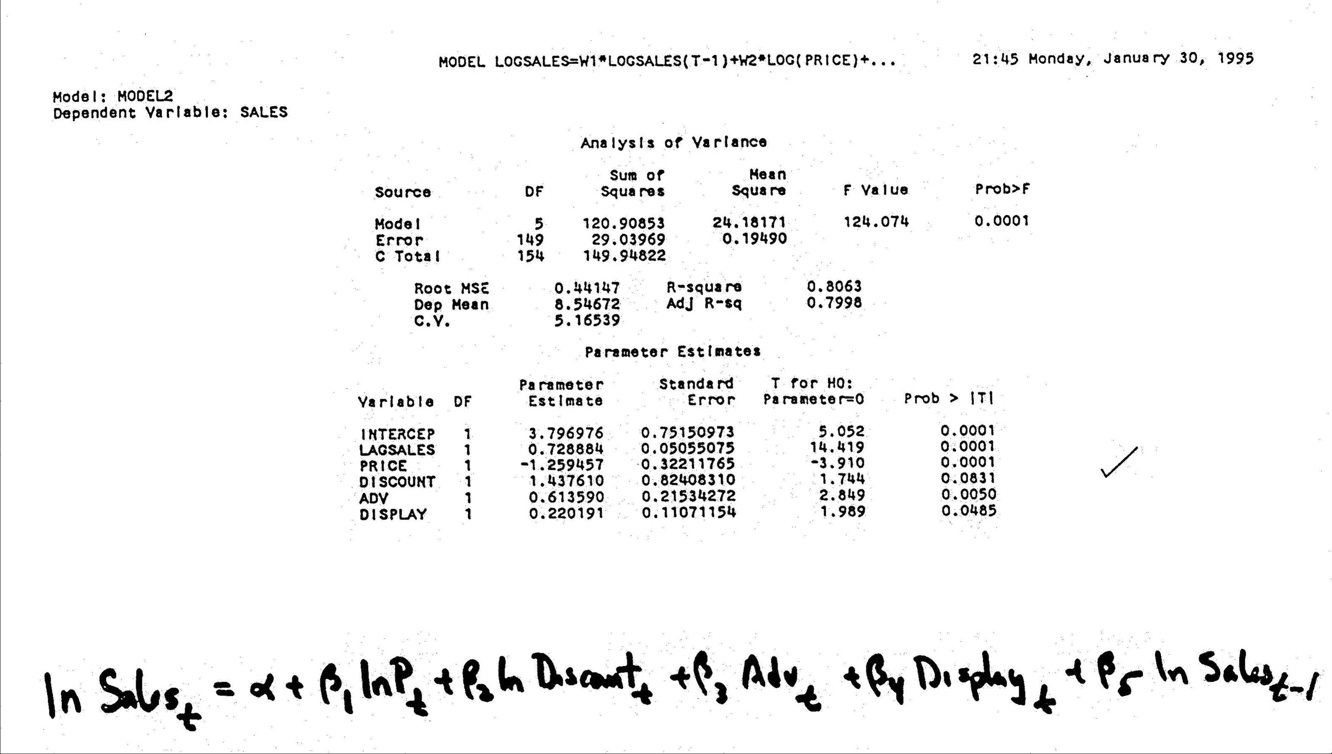
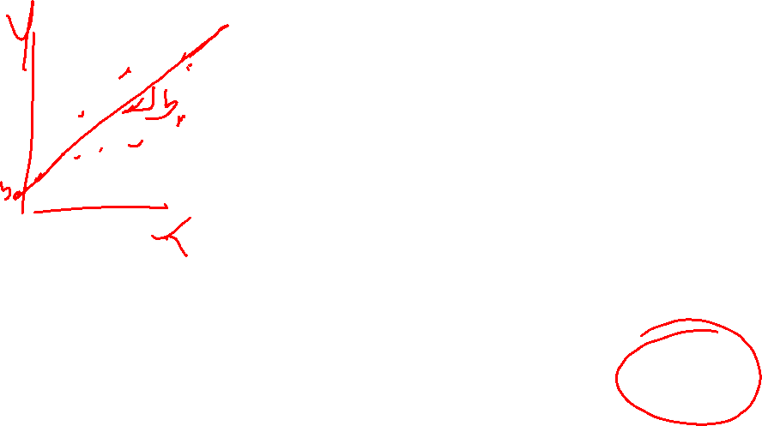

Slide 6
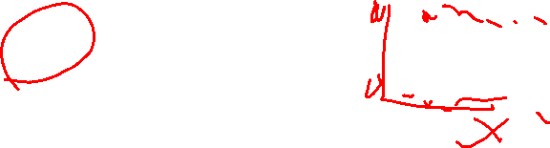
What if Y is Categorical?
Y is not a continuous (ratio or interval scaled) variable
  Dichotomous (2 Y outcomes)
  Multichotomous (> 2 Y outcomes)
Examples?
  Behaviors
  Psychographics
  Demographics

Slide 7
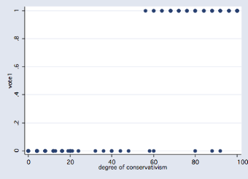
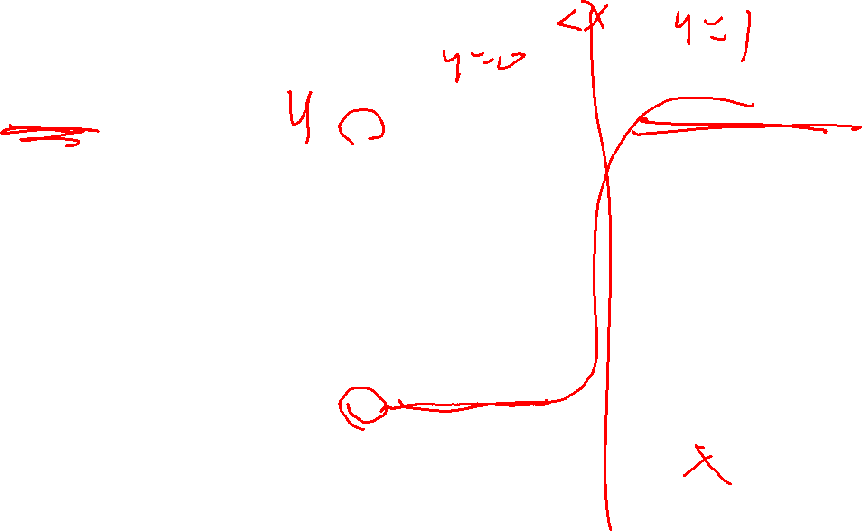
Categorical Y?
Clinton Impeachment
In 1999, President Bill Clinton was impeached by the US House of Representatives
The Senate then voted on whether to remove Clinton from office
67 votes were required, but the measure only got 45 votes
Dependent variable: Guilty (1) or Not Guilty (0) --> "vote“
Independent variable: degree of ideological conservatism
  0-100 scale, 100 is most conservative

Slide 8
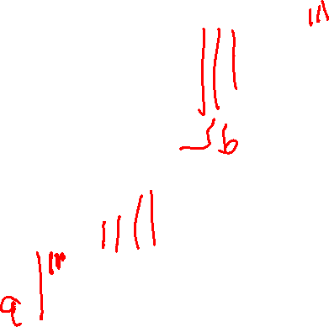
Categorical Y ⇒ Avoid Regression
Clinton Impeachment
What if use OLS regression?
Vote = a + b Conservativism
A one point increase in conservatism increases the estimated “probability” of voting for impeachment by b
OLS Regression has obvious theoretical problems (badly behaved residuals). However, practically it reflects relationships fairly well

Slide 9
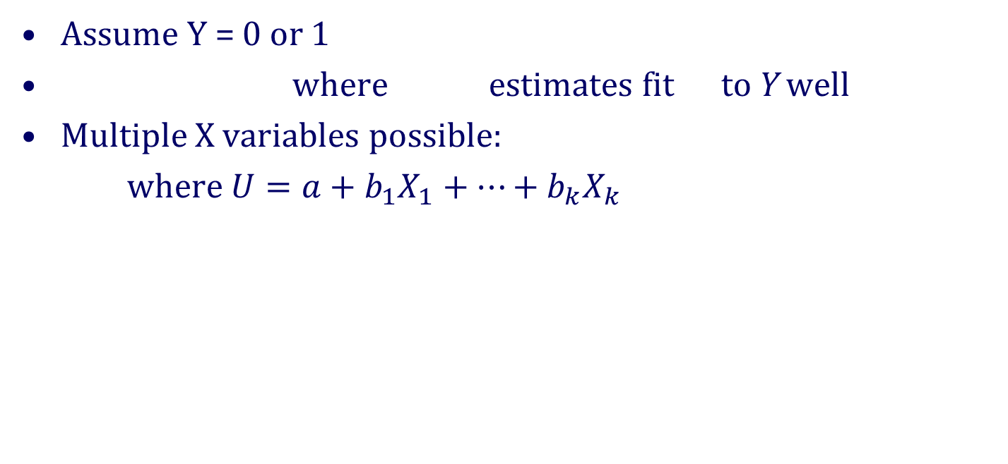




Categorical Y ⇒ How estimate Y = f(x)?
Assume Y = 0 or 1
where estimates fit to Y well
Multiple X variables possible:
where $U=a+b_{1}X_{1}+…+b_{k}X_{k}$
$$\hat{Y}$$
$$X$$
$$U$$

Slide 10
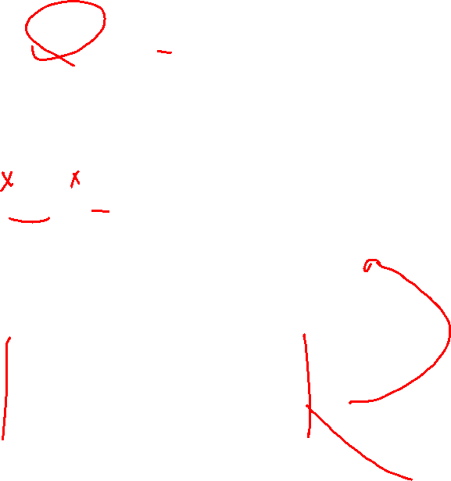
Machine Learning
Trees inside a “black box”
Computer chooses #s and order of Xs in branches to predict Y as well as possible
0 x
Computer classes #s and order of Xs in branches to predict Y as well as possible
 | 0
0 |  |  | x
 | 0 |  | x | x
 |  |  |  | x | x
 | 0 |  | 0 |  | x
 |  |  |  | 0

Slide 11
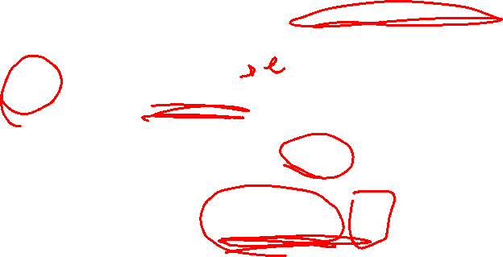
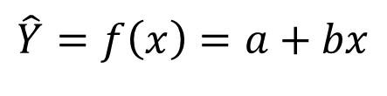
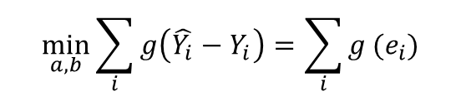
Linear Programming
Want close to
Subject to for all i
$$\hat{Y}=f\left(x\right)=a+bx$$
$$\min_{a,b}\sum_{i}{g\left(\hat{Y_{i}}−Y_{i}\right)}=\sum_{i}{g}(e_{i})$$

Slide 12

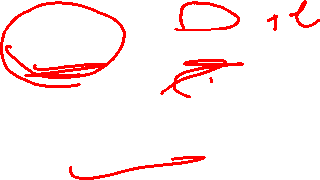
Discrete Choice
Assign a distribution to and specify
Want close to
Allows for statistical estimation
$$\hat{Y}=f(x)=\frac{e^{a+bx}}{1+e^{a+bx}}$$

Slide 13

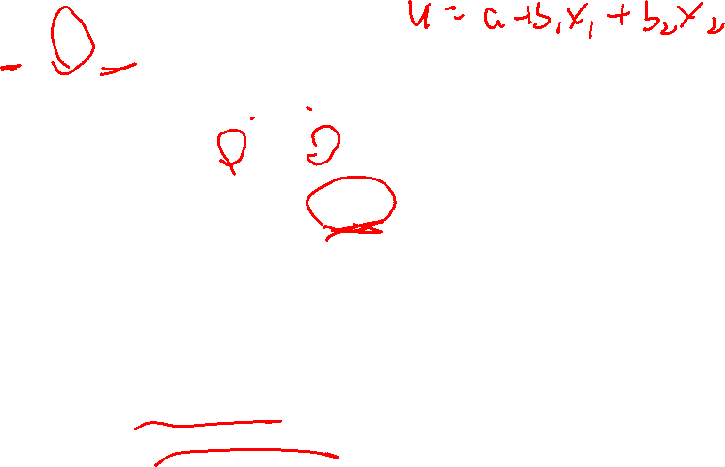
Discrete Choice: Technical
Error term assumptions
  Logit: Extreme Value Type 1 or Gumbel
  Probit: Standard Normal
$$\text{If} \text{assume} U_{k}=0$$
$$P\left(j \text{preferred} \text{to} k\right)=P\left(U_{j}>0\right) \\ =P\left({\hat{U}}_{j}+ε_{j}>0\right)$$
$$=P\left({\hat{U}}_{j}>−ε_{j}\right)$$

Slide 14
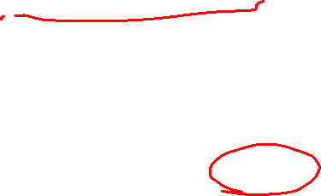

Discrete Choice Model Estimation
Non-linear Least Squares
  MINIMIZE
    $$SSR=\sum_{i=1}^{n}{{(Y_{i}−P\left(Y_{i}=1\right))}^{2}}$$
Maximum Likelihood (MLE)
  MAXIMIZE
    $$lnL=\sum_{i=1}^{n}{\{Y_{i}∗\ln\left(P\left(Y_{i}=1\right)\right)+}{(1−Y}_{i})∗\ln\left(1−P\left(Y_{i}=1\right)\right)\}$$

Slide 15

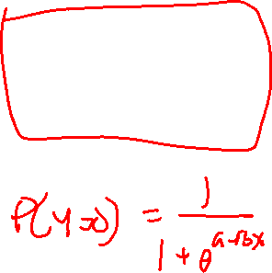
Discrete Choice Models : Effect of Changing the Constant a
Larger
“a”
Smaller
“a”
X

Slide 16
Discrete Choice Models: Effect of Changing the Slope b
Larger “b”
Smaller “b”
X

Slide 17
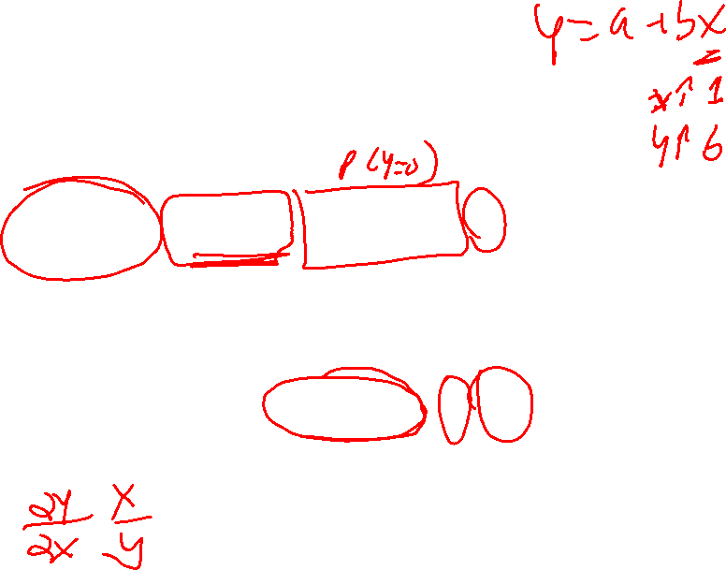
Elasticity of X on Y
Effect of X on Y
Elasticity of X on Y

Slide 18
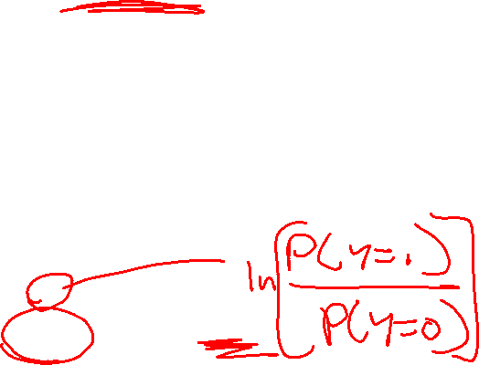
Log Odds Ratio
Exp(b) is the impact of a unit change of X on P/(1-P)

Slide 19
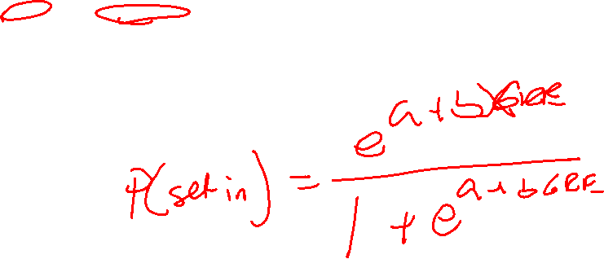
Ex: Admit = f(GRE)
Coefficient Estimate Std. Error z value Pr(>|z|)
Intercept -2.901344 0.606038 -4.787 1.69e-06 ***
GRE 0.003582 0.000986 3.633 0.00028 ***
Signif. codes: 0 ‘***’ 0.001 ‘**’ 0.01 ‘*’ 0.05 ‘.’
Chi-squared test: X2 = 20.9, df = 3, P(> X2) = 0.00011
AdmitData

Slide 20

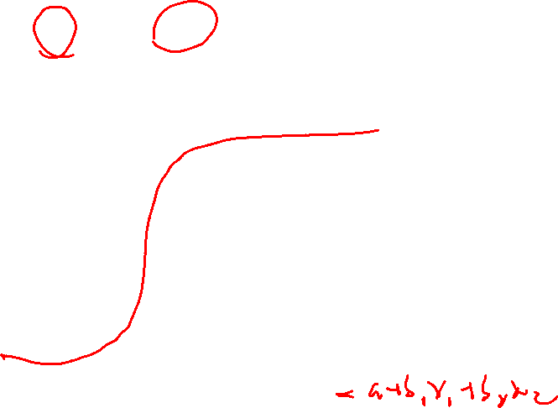
Binary Logit: Multiple Xs
$$U=a+b_{1}X_{1}+…+b_{k}X_{k}$$
Then $P\left(Y=1\right)=\frac{exp⁡(U)}{1+exp⁡(U)}$
Y 1-
0-
U

Slide 21
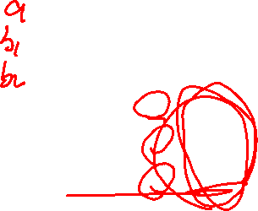
Ex: Admit = f(GRE, GPA, Rank)
AdmitData
Coefficients Estimate Std. Error z value Pr(>|z|)
Intercept -3.989979 1.139951 -3.500 0.000465 ***
gre 0.002264 0.001094 2.070 0.038465 *
gpa 0.804038 0.331819 2.423 0.015388 *
rank_dummy2 -0.675443 0.316490 -2.134 0.032829 *
rank_dummy3 -1.340204 0.345306 -3.881 0.000104 ***
rank_dummy4 -1.551464 0.417832 -3.713 0.000205 ***

Slide 22

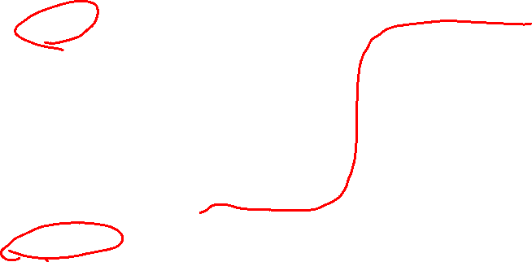
Binary Logit/Probit <-> “Group” Membership
y = 1 (in group)
Can see this as estimating
P (group membership)
y = 0 (not in group)
Group defined relative to behavior, opinion, interest, descriptors

Slide 23
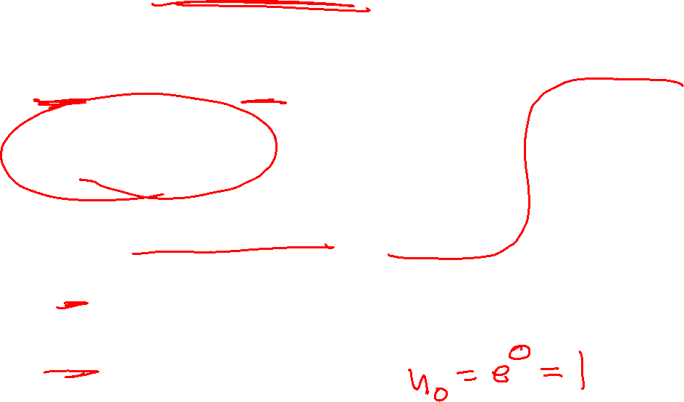

Discrete Choice Models
Binary Logit and Probit
Utility$=a+b_{1}X_{1}+b_{2}X_{2}$+…

Slide 24
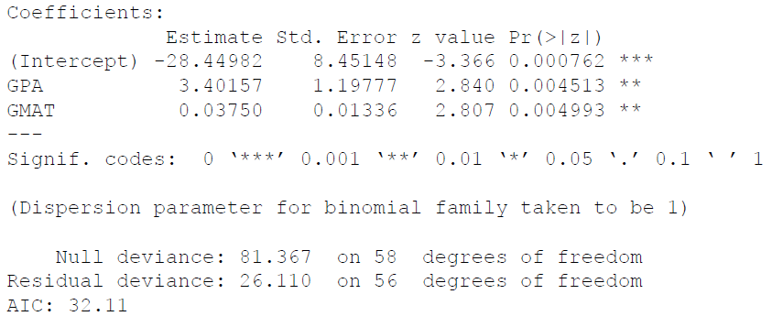
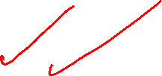
Ex: Logit
P(Accepted to Grad School)

Slide 25
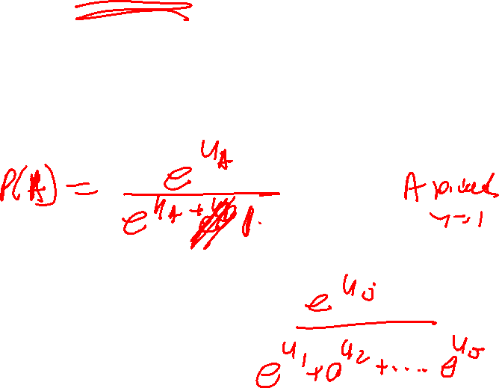
What if > 2 Y Outcomes
Multinomial Logit/Probit
Y = A, B, C, D, … not just A (when Y=0) and B (when Y=1)
Examples?

Slide 26
Multinomial Logit/Probit Technical

Slide 27
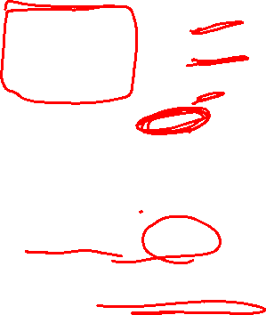
Ex: Fishing Choices
Fishing
Coefficients Estimate Std. Error z-value Pr(>|z|)
Boat 0.8713749 0.1140428 7.6408 2.154e-14 *** Charter 1.4988884 0.1329328 11.2755 < 2.2e-16 *** Pier 0.3070552 0.1145738 2.6800 0.0073627 ** Price -0.0247896 0.0017044 -14.5444 < 2.2e-16 *** Catch 0.3771689 0.1099707 3.4297 0.0006042 ***
Log-Likelihood: -1230.8
McFadden R^2: 0.17823
Likelihood Ratio Test : chisq = 533.88 (p.value = < 2.22e-16)

Slide 28
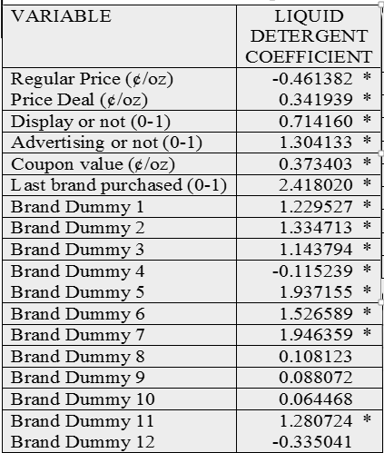
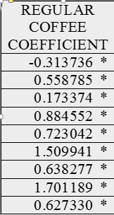
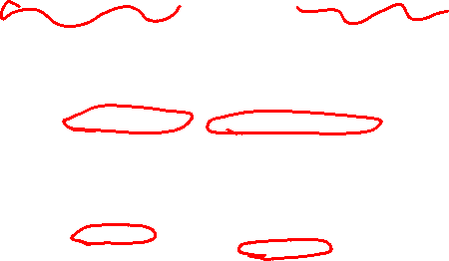
Ex: Detergent and Coffee

